Slide 1

Clustering Algorithms
Nisal Mihiranga

Slide 2



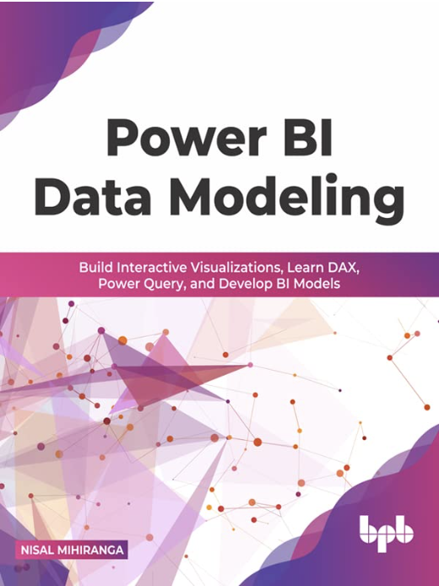
Facilitator
Nisal Mihiranga
Areas of Interest & Expertise:
AI, Technology, Science, Teaching, Consulting, Mentoring
Experience:
Head of AI and Data Science, Architect at
Zone24x7 pvt Ltd
Corporate Trainer
12 Years of Industry exposure to Data Engineering, Data Science and Business Intelligence
Credentials:
M.Sc in Data Science
B.Sc in Information Technology
Microsoft Certified Trainer

Slide 3
Curriculum
Week | Module
Week 1 | Python for Machine Learning
Week 2 | Introduction to Machine Learning
Week 3 | Data Transformation and Analysis
Week 4 | Classification
Week 5 | Regression
Week 6 | Clustering Algorithms
Week 7 | Neural Networks
Week 8 | MLOPS, Machine Learning in Cloud

Slide 4
Learning Outcomes
Understand and Apply Different Clustering Algorithms: Learners will be able to differentiate between various clustering techniques, such as K-Means, Hierarchical Clustering
Evaluate the Quality of Clustering Results: Learners will be able to assess clustering performance using evaluation metrics

Slide 5
Clustering Algorithms

Slide 6

Supervised and Unsupervised Learning
Grouping labeled Data
Classification
Grouping Unlabeled Data
Clustering

Slide 7
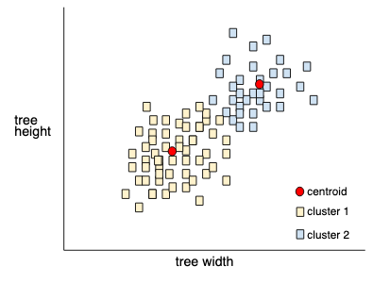
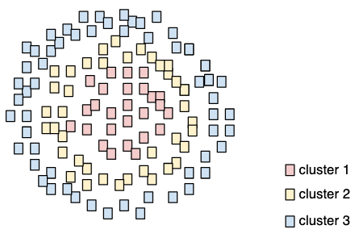
What is Clustering
Grouping related data , particularly during unsupervised learning.
Clustering is used to group similar data points together based on their characteristics.
Clustering machine-learning algorithms are grouping similar elements in such a way that the distance between each element of the cluster are closer to each other than to any other cluster.

Slide 8
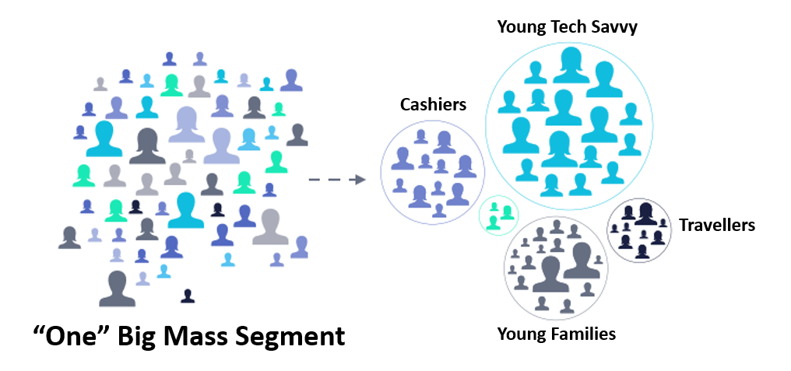

Use Cases in Clustering
What is clustering Good for,
Market segmentation
Social network analysis
Search result grouping
Medical imaging
Image segmentation
Anomaly detection

Slide 9
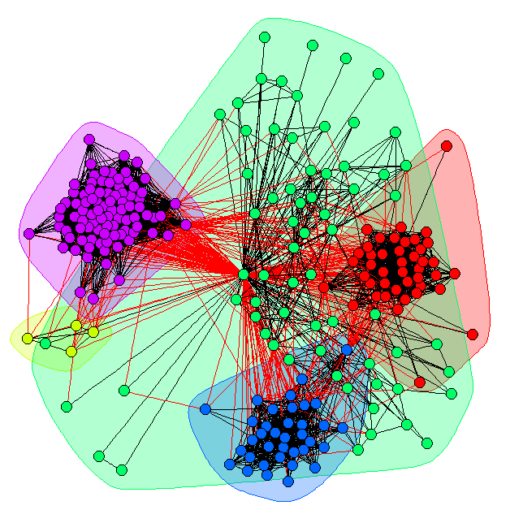
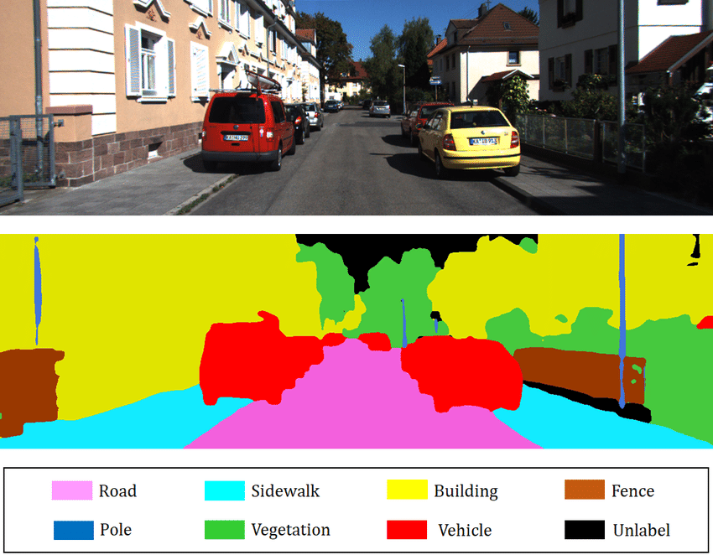
Applications of Clustering
Image Segmentation
Community Detection Social Media

Slide 10
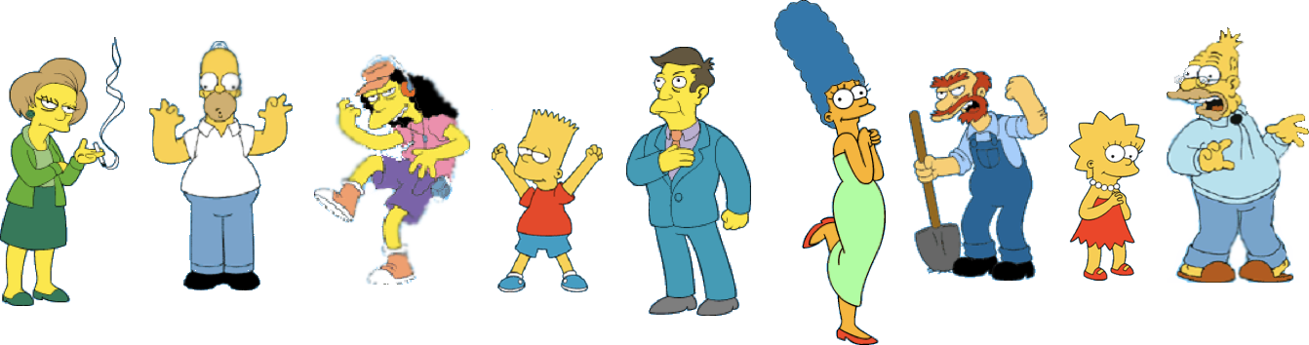

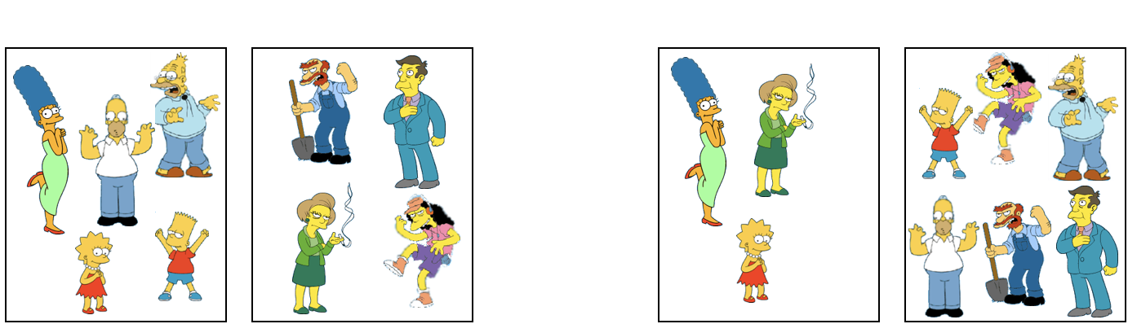
Typical workflow for clustering
Unlabeled data
Feature extraction
Unsupervised ML algorithm for data clustering
Clustering is subjective, given a new input image assign it in to an existing cluster.
Simpson’s family
School employees
Female
male

Slide 11
Clustering Algorithms
Partitioning methods:
Construct various partitions and then evaluate them by some criterion
K-Mean clustering
Hierarchical methods:
Create a hierarchical decomposition of the set of objects using some criterion
Agglomerative (bottom-up)
Divisive (top-down)

Slide 12
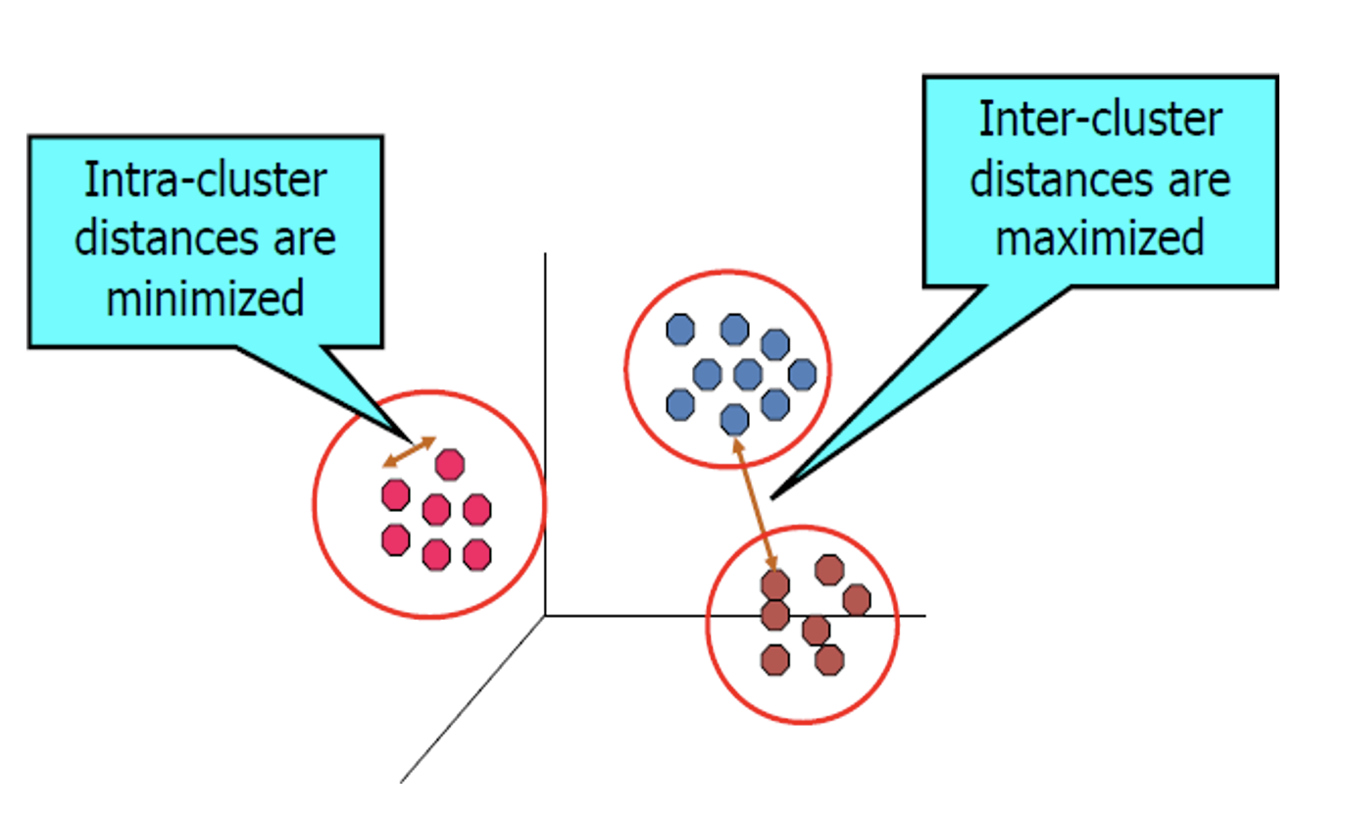
Cluster:
A collection of data objects with
Similar ones are in the same cluster
Dis-similar objects in other clusters

Slide 13
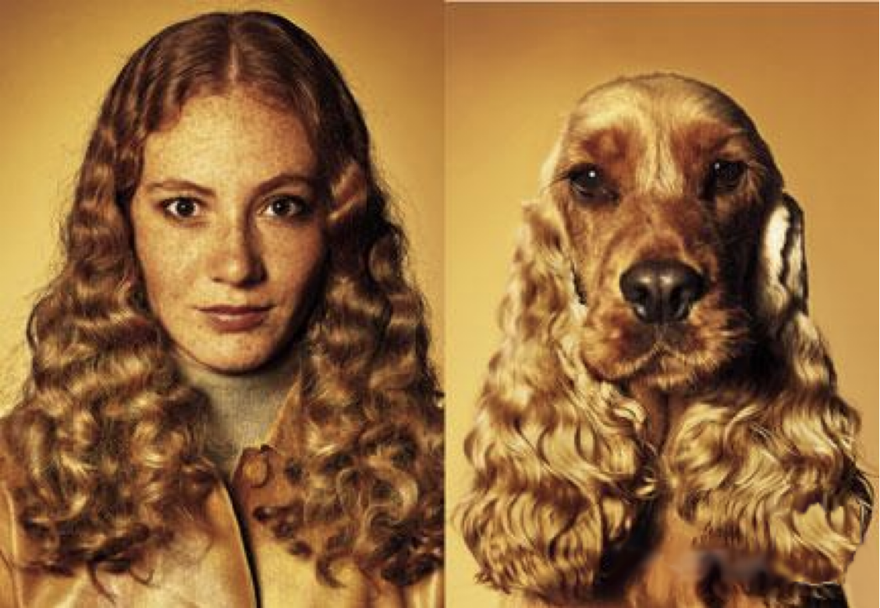
What is Similarity?
Clustering is based on the given notion of similarity, no labels are given.
However, without labels, a meaningful measure of similarity can be hard to define.“We know it when we see it
Remove subjectivity by defining similarity in terms of a distance between vectors or correlations between random variables.

Slide 14
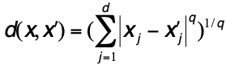
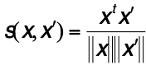
Distance Matrix
Distance between two instances x and x’, where q >= 1 is a selectable parameter and d is the number of attributes (called the Minkowski Metric)
Cosine of the angle between two vectors (instances) gives a similarity function:

Slide 15
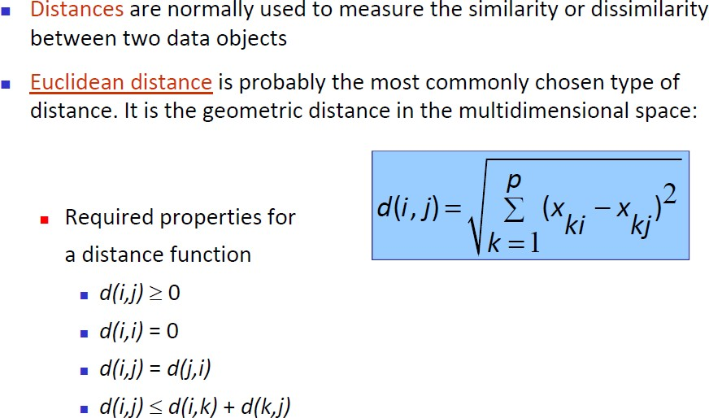
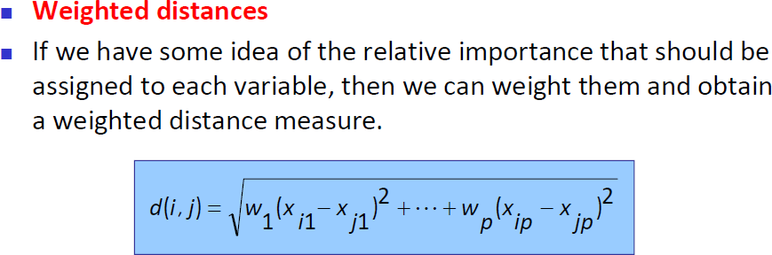
Distance Matrix

Slide 16
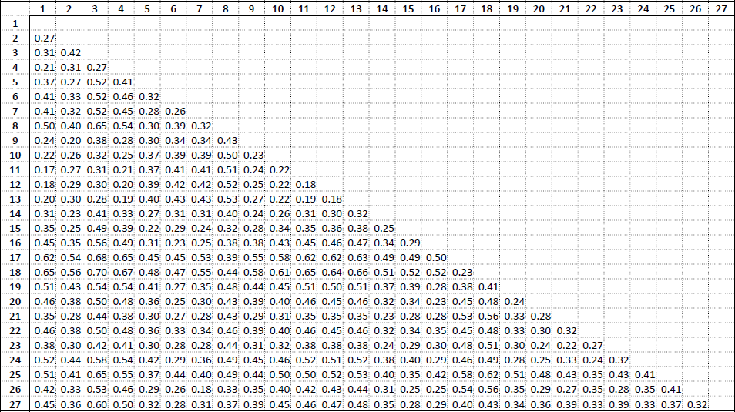
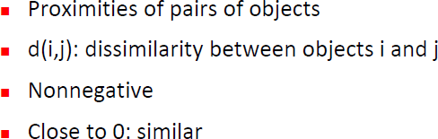
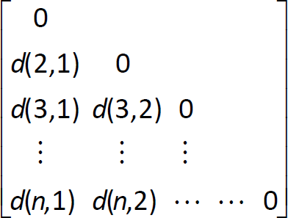
Dissimilarity Matrix

Slide 17
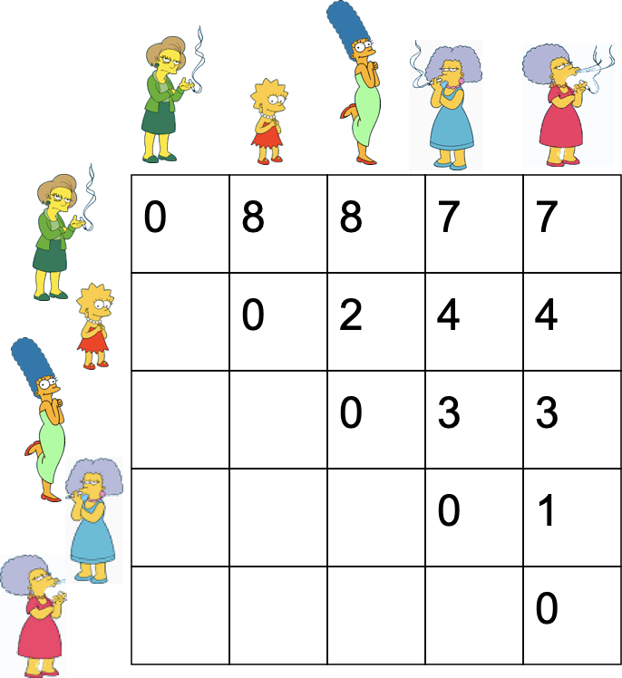

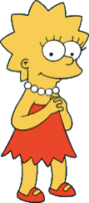


We begin with a distance matrix which contains the distances between every pair of objects in our database.
D( , ) = 8
D( , ) = 1

Slide 18
Partitioning Clustering : K- means clustering
K-means is to partition a set of objects into K clusters in such a way that the sum of the squared distances between the objects and their assigned cluster mean is minimized.
Algorithm works as follow:
Decide on a value for k.
Initialize the k cluster centers (randomly, if necessary).
Decide the class memberships of the N objects by assigning them to the nearest cluster center.
Re-estimate the k cluster centers, by assuming the memberships found above are correct.
If none of the N objects changed membership in the last iteration, exit. Otherwise goto 3.
Notes:
Step 1: select the number of clusters you want to identify. This is K in K-mean clustering
Step 2: Randomly select 3 distinct data points

Slide 19
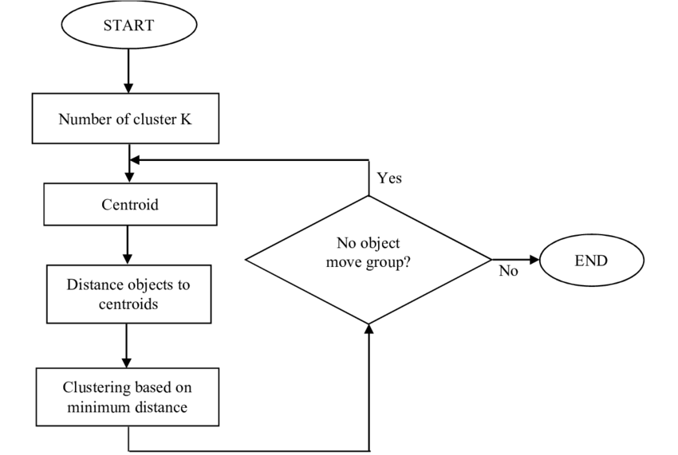

Slide 20
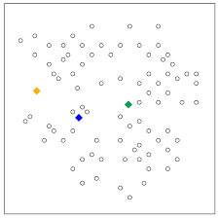
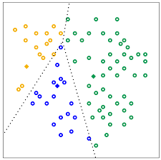
Partitioning Clustering : K- means clustering
Step 1: If we choose a k of 3, and therefore the algorithm randomly picks 3 centroids.
Step 2: The algorithm assigns each point to the closest centroid to get k initial clusters.

Slide 21
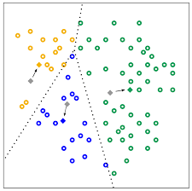
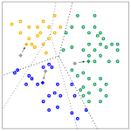
Partitioning Clustering : K- means clustering
Step 3: For every cluster, the algorithm recomputes the centroid by taking the average of all points in the cluster.
Step 4: The algorithm repeats the calculation of centroids and assignment of points until points stop changing clusters.

Slide 22
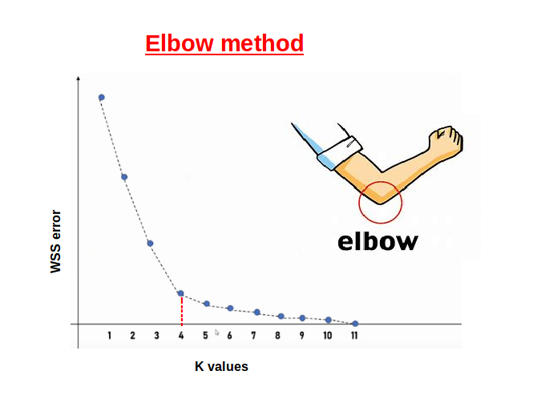
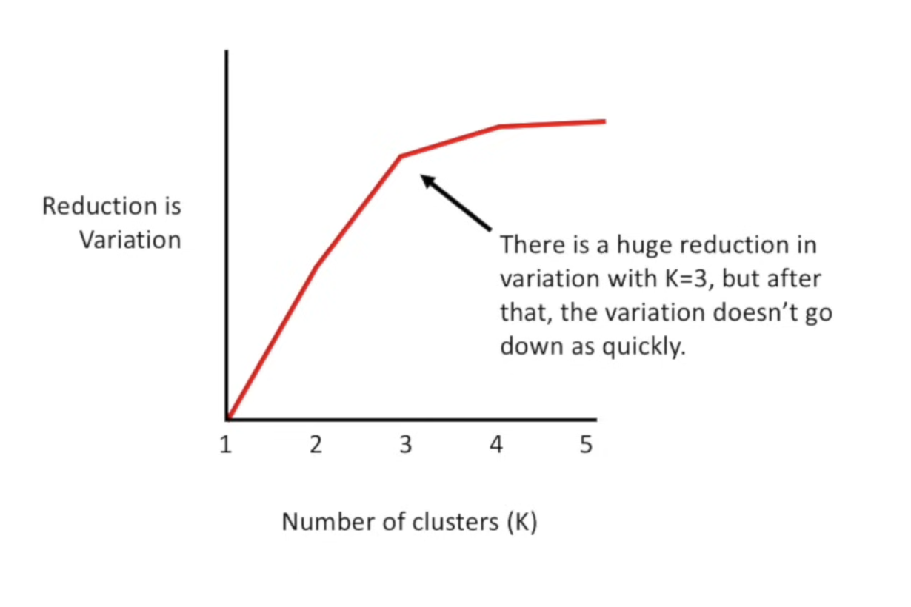
Determine the K : K- means clustering
Elbow Method
Run K-means with various values for K
Plot the within-cluster sum of squares(WCSS) against K
Identify the Elbow point
Choose the optimum K
Notes:
### Elbow Method:
1. **Run K-Means with Various Values of \( K \)**:
- Start by running the K-Means algorithm on your dataset for a range of \( K \) values (for example, from 1 to 10).
- For each value of \( K \), calculate the within-cluster sum of squares (WCSS), which measures the sum of squared distances between each data point and its assigned centroid within the cluster.
2. **Plot the WCSS Against \( K \)**:
- Plot the WCSS values against the corresponding \( K \) values on a graph.
- You'll see a downward trend in the WCSS as \( K \) increases because adding more clusters generally reduces the distance of data points to their respective centroids.
3. **Identify the "Elbow" Point**:
- Look for the point on the plot where the rate of decrease in WCSS starts to slow down.
- This point resembles an "elbow" shape on the plot, where adding more clusters beyond this point does not significantly decrease the WCSS.
4. **Choose the Optimal \( K \)**:
- The optimal \( K \) is typically the value at the elbow point on the plot.
- Beyond this point, adding more clusters may not improve the clustering quality significantly, and it might lead to overfitting.
### Simplified Explanation:
Think of the elbow method like this:
- Imagine you're fitting clusters to your data. At first, as you increase \( K \), the clusters become more specific, and the points get closer to their centroids. This reduces the WCSS.
- However, there comes a point where adding more clusters doesn't make a significant improvement in reducing the WCSS. It's like stretching an elastic band: initially, pulling it reduces its length, but after a certain point, stretching it more doesn't make much difference.
- The elbow point on the plot represents this "sweet spot" where adding more clusters doesn't offer much benefit in reducing WCSS.
By using the elbow method, you can find a balance between having enough clusters to capture the underlying structure of the data and avoiding overly complex clustering solutions.

Slide 23
Partitioning Clustering : K- means clustering
K- means clustering Implementation
Import required libraries and packages and load the dataset
import numpy as np
import matplotlib.pyplot as plt from sklearn.cluster
import KMeans
import seaborn as sns
# Load the 'tips' dataset from Seaborn
tips = sns.load_dataset('tips')
# Use two features for simplicity X = tips[['total_bill', 'tip']]

Slide 24
Partitioning Clustering : K- means clustering
K- means clustering Implementation
Initializing and fit K-means
n_clusters = 3
# Set the desired number of clusters
kmeans = KMeans(n_clusters=n_clusters, random_state=42)
kmeans.fit(X) centroids = kmeans.cluster_centers_
labels = kmeans.labels_

Slide 25
Partitioning Clustering : K- means clustering
K- means clustering Implementation
Visualize the clusters
plt.scatter(X['total_bill'], X['tip'], c=labels, cmap='viridis') plt.scatter(centroids[:, 0], centroids[:, 1], marker='x', s=200, linewidths=3, color='r', label='Centroids')
plt.legend(loc='best')
plt.title('K-Means Clustering')
plt.xlabel('Total Bill')
plt.ylabel('Tip')
plt.show()

Slide 26
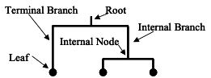
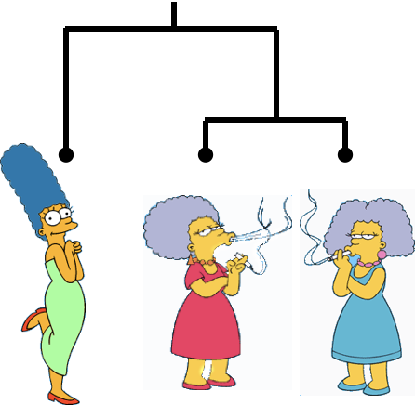
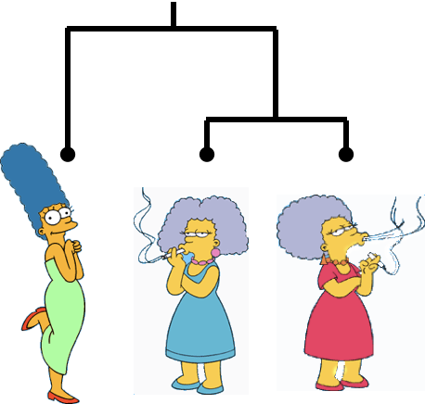
Hierarchical Clustering
Dendrogram: A Useful Tool for Summarizing Similarity Measurements
The similarity between two objects in a dendrogram is represented as the height of the lowest internal node they share.

Slide 27
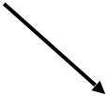
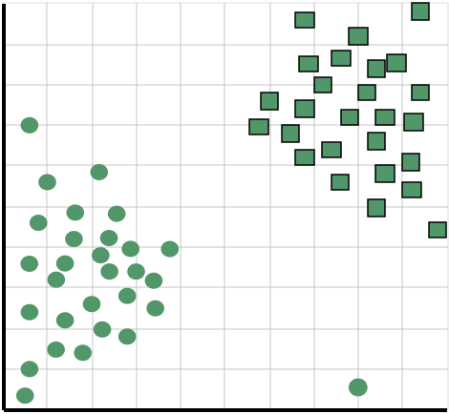
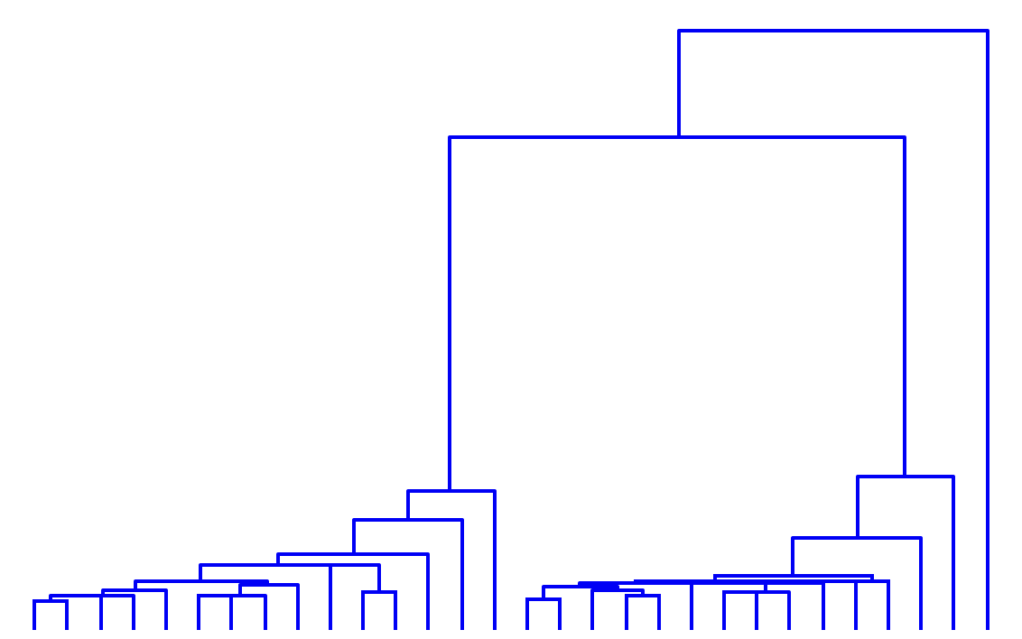
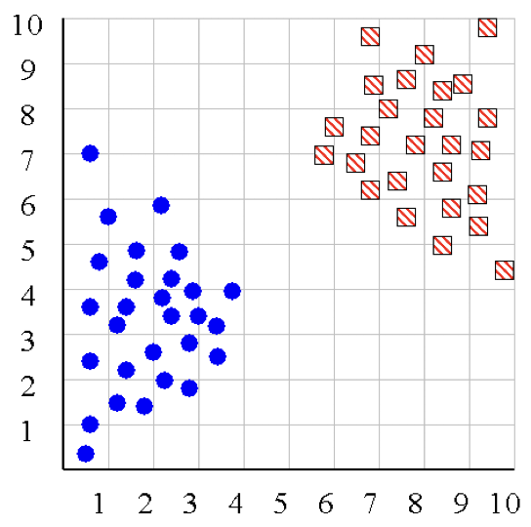
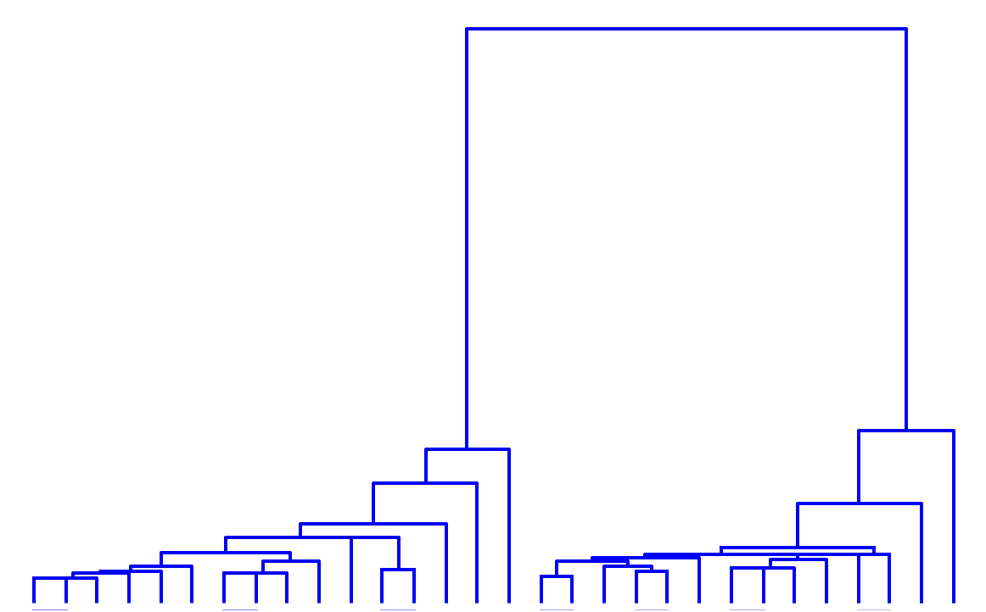
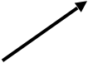
Hierarchical Clustering
We can look at the dendrogram to determine the “correct” number of clusters.
One potential use of a dendrogram: detecting outliers
The single isolated branch is suggestive of a data point that is very different to all others
Outlier

Slide 28
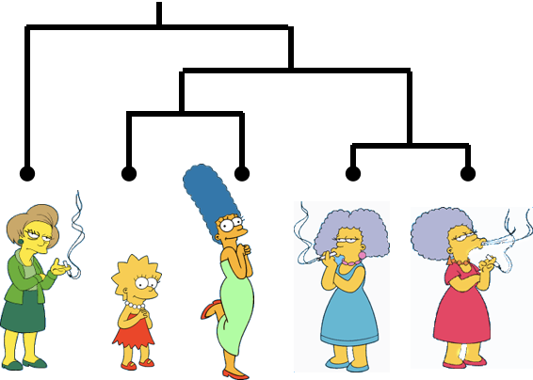
Hierarchical Clustering
The number of dendrograms with n leafs = (2n -3)!/[(2(n -2)) (n -2)!]
Number Number of Possible
of Leafs Dendrograms
2 1
3 3
4 15
5 105
... …
34,459,425
Bottom-Up (agglomerative): Starting with each item in its own cluster, find the best pair to merge into a new cluster. Repeat until all clusters are fused together.
Top-Down (divisive): Starting with all the data in a single cluster, consider every possible way to divide the cluster into two. Choose the best division and recursively operate on both sides.

Slide 29


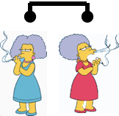

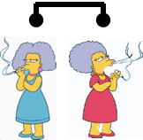
Hierarchical Clustering
Bottom-Up (agglomerative): Starting with each item in its own cluster, find the best pair to merge into a new cluster. Repeat until all clusters are fused together.
Consider all possible merges…
…
Choose the best

Slide 30


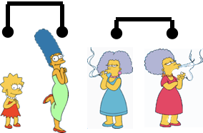
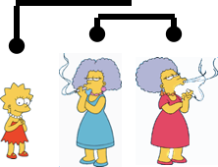
Hierarchical Clustering
Bottom-Up (agglomerative): Starting with each item in its own cluster, find the best pair to merge into a new cluster. Repeat until all clusters are fused together.
Consider all possible merges…
…
Choose the best
Consider all possible merges…
…
Choose the best

Slide 31
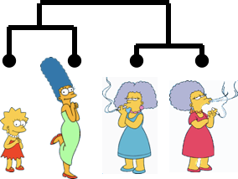
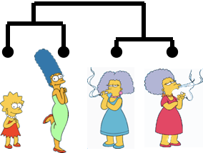
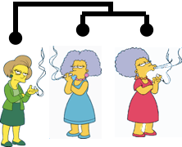
Hierarchical Clustering
Bottom-Up (agglomerative): Starting with each item in its own cluster, find the best pair to merge into a new cluster. Repeat until all clusters are fused together.
…
Choose the best
Consider all possible meres…
Consider all possible merges…
…
Choose the best
Consider all possible merges…
…
Choose the best

Slide 32
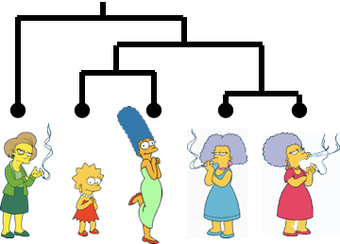
Hierarchical Clustering
Bottom-Up (agglomerative): Starting with each item in its own cluster, find the best pair to merge into a new cluster. Repeat until all clusters are fused together.
Consider all possible meres…
…
Choose the best
Consider all possible merges…
…
Choose the best
Consider all possible merges…
…
Choose the best

Slide 33
Hierarchical clustering
Hierarchical clustering Implementation
import required libraries and packages and load the dataset
import numpy as np
import matplotlib.pyplot as plt
import seaborn as sns from sklearn.preprocessing
import StandardScaler from scipy.cluster.hierarchy
import dendrogram, linkage
# Load the 'tips' dataset from Seaborn tips = sns.load_dataset('tips')
# Use two features for simplicity
X = tips[['total_bill', 'tip']].)

Slide 34
Hierarchical clustering
Hierarchical clustering Implementation
import required libraries and packages and load the dataset
scaler = StandardScaler()
X_scaled = scaler.fit_transform(X)
Hierarchical clustering
linked = linkage(X_scaled, method='ward', metric='euclidean')

Slide 35
Hierarchical clustering
Hierarchical clustering Implementation
Dendrogram Visualization
plt.figure(figsize=(12, 6))
dendrogram(linked,
orientation='top',
labels=np.array(range(len(X))),
distance_sort='descending',
show_leaf_counts=True)
plt.title('Hierarchical Clustering Dendrogram')
plt.xlabel('Sample Index')
plt.ylabel('Euclidean Distance')
plt.show()

Slide 36
Hierarchical Clustering Methods Summary
No need to specify the number of clusters in advance.
Hierarchical nature maps nicely onto human intuition for some domains.
They do not scale well: time complexity of at least O(n²), where n is the number of total objects.
Like any heuristic search algorithms, local optima are a problem.
Interpretation of results is (very) subjective.

Slide 37
Q&A

Slide 38





Thank You
Nisal Mihiranga
Head of AI & DS at Zone24x7
Consultant, Trainer
M: +94 71 726 3044

